Slide 1
Internet business concepts Week #3: seo friendly html & intro to keywords
September 2018 v1.3

Slide 2



it’s a lot easier to create friendly websites today
10 years ago, a web developer needed to know a lot more HTML to make sure the site they built was SEO friendly.
Today, modern CMSs like Wordpress allow web devs to build pretty SEO friendly websites…but you should still know the basics of what they’re looking for.

Slide 3
What is seo?
Search
Engine
Optimization
A method to increase the ranking of a website or specific webpage so that it appears higher in organic* search engine results.
* organic: natural, as determined by the search engine’s algorithm
SEO can be split up into 2 groups: on-site SEO work, and off-site SEO work.
The following examples will be about on-site SEO work that you can do.

Slide 4
Why is having a seo friendly html site important?
Search engines are getting pretty smart, but having clean & friendly code helps the SEs better crawl and index your website.
As amazing your new website might look to human beings, the search engines will only view it in terms of what information you’re telling them is important.

Slide 5
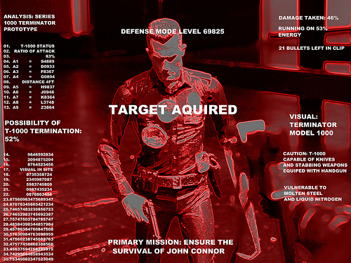
How a search engine sees your website
Remember those scenes in the Terminator movie where we get to see what the killer robot is looking at?

Slide 6
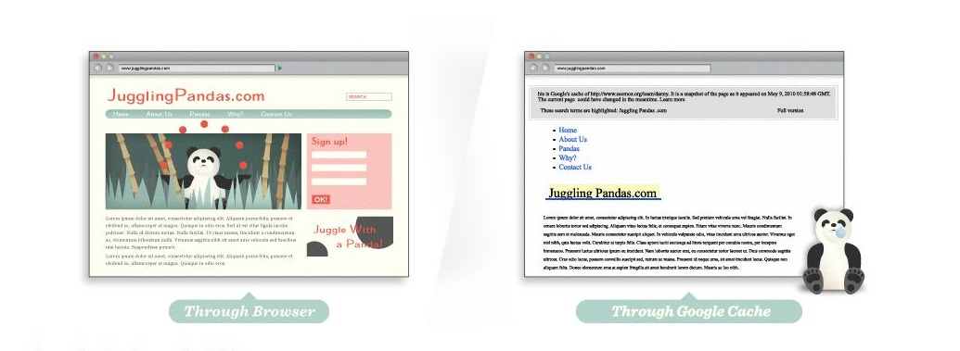
How a search engine sees your website
Well, it’s kind of like that from the search engine’s POV…

Slide 7
How a search engine sees your website
Test it out for yourself!
Go view what a search engine is seeing by entering a URL at BrowSEO.net

Slide 8
The takeaway:
Make your most important search terms crawlable
Include ALT descriptions with your images -- make sure that they are labeled smartly!
Headings are a way to tell a search engine what content is the most important content on a page.
If you embed a video, have a short description of it
The search engine is a little like a blind person – by describing your site’s main purpose & imagery, you’re helping make it easier for the SE to index.

Slide 9
Deep links throughout website
Search engines dig links throughout your website. It helps them find pages that are further away from top level categories & the homepage.
Make sure that every important page gets linked to, preferably by a variety of ways.
Don’t create orphan pages.

Slide 10
Common mistakes for non-searchable pages
Robots.txt file: you can list pages in this file asking SEs to not index a certain page. When you’re building your site, you may want this. Sometimes people forget that they did this!
Lots of pages: Sites with 100s of pages can easily forget to link to them, often relying on site searches for users to find content. This doesn’t get the page listed on a SE.
Using Javascript or Flash: SEs don’t see this content, so they won’t follow these links.

Slide 11
Common mistakes for non-searchable pages
Content behind forms/password walls: Great if you want that content to not be indexed, bad if you want to use that as a source for inbound SERPs searches.

Slide 12

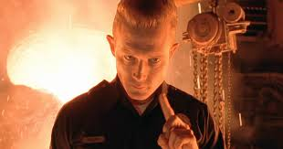
Keywords - what are they?
Remember that Terminator robot guy?

Slide 13
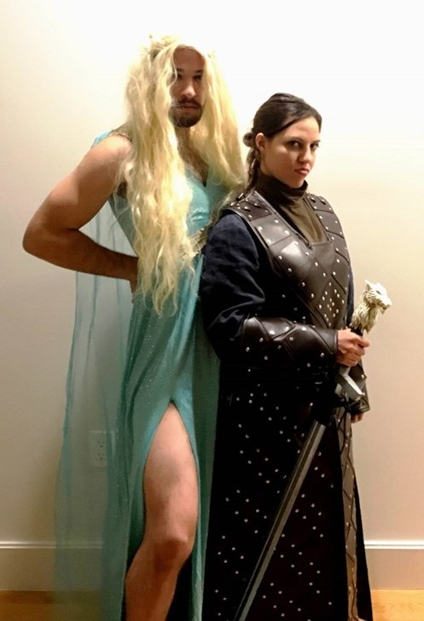

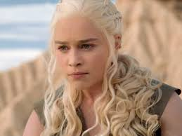



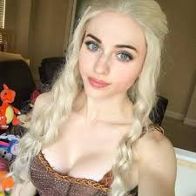
What are the keywords for this?

Slide 14


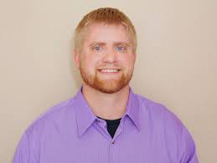

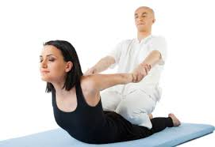
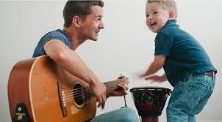
Ok, so what is the keyword for this?

Slide 15
Keywords in your page content
A little more to build your knowledge on the importance of keywords on your website.
You already know keywords help SEs direct people to your website, so having good keywords IN good content is vital.
Here are some rules of thumb that will help you rank pages on SERPs.

Slide 16
Where to place keywords
In your Title tag: Helps the SE “know” what the main topic for this page is about.
Near the top of your page of content: In your Heading text, and maybe once or twice again in the first paragraph.
In a web friendly URL: Also helps the SE by saying “this is the subject of this page”.
Example: “mywebsite.com/football/teams/bc-lions/2015-season
(Note: it’s OK to have dashes for the deeper page URLs)

Slide 17
Where to place keywords
In your Meta description tag for the page: Although this is getting less and less important, it takes a moment of your time.
Images on the page: Even better, having some variety:
Example: “bc-lions-training-camp-2015”, “bc-lions-grey-cup-2015”, “bc-lions-workout-practice”

Slide 18
Don’t overstuff keywords
People used to do this to try and get on Page 1 of SERPs. That was 10 years ago. Google doesn’t fall for this tactic anymore.
Keywords are important, but write your content FIRST so it can be appreciated by a HUMAN BEING.
Then, you can always go back and add a couple more keywords into it.

Slide 19
Keyword cannibalization
This happens when you use the same keyword to link to multiple pages on your website:
Check out my BC LIONS store! (Goes to a store page)
See photos from the latest BC LIONS game! (Goes to image gallery)
Find your romantic match on my BC LIONS dating page! (Goes to a dating page…you get the idea)

Slide 20
Best practices for <title>title</title> tags
Be mindful of space. Try to keep your titles to 50-65 characters, but if you can make it shorter, the better.
Keep your primary keyword near the beginning.
Adding the name of your company/brand: if it makes sense, you can add it at the end of the tag
Example: The #1 BC Lions fanpage! | BC Lions Fanzone.com
Grab Attention: A title tag appears on SERPs. Does it grab the attention of your target audience, making them want to click on it?

Slide 21
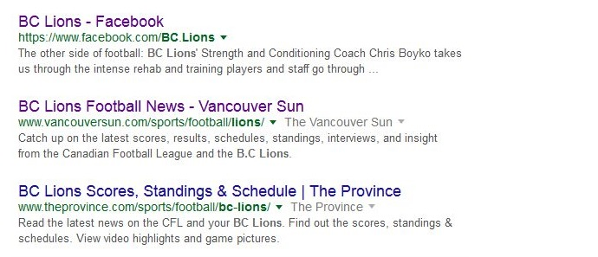
What are Meta descriptions?

Slide 22
Meta descriptions – rules of thumb
What if there’s no meta description?: Search engines will use your meta description if there’s one on the page. If not, they’ll pull the content from the top of the page.
Over 160 characters, the SE results will trail off in ellipses (…)
Grab Attention: As with your Title tag text, use your page’s Meta Description to draw the reader in. What’s going to make them want to click on this SERP?

Slide 23
How do I know what keywords to use?
There are more advanced ways to learn what keywords you can use to draw people to your site, but you’re just starting out.
Focus on your PRIMARY SUBJECT MATTER FOR THE PAGE.
Example: BC Lions Fanpage
If it’s a secondary (deeper) page about the subject, then that becomes your new PRIMARY KEYWORD for that deeper page.
Example: BC Lions Team Roster, BC Lions Games 2015, etc.

Slide 24
Keep this in mind about keywords:
The content on your page can be edited & re-written down the road.
When you start getting some experience in writing content for a website, using analytics and keyword research, you’ll want to experiment to see how you can change the SERPs for a page.
Some pages get great SERP rankings, other not so much. It depends on different factors, like:
The level of competition for that keyword (how many other pages exist for it), number of searches, the site’s authority, links to that page, etc.

Slide 25


Assignment: food blog
Look
Look at 3 different food blogs.
Have
Have a closer look at one of their average-sized articles that has images associated with it.
Analyze
Now: analyze the page with an eye towards what you’ve learned about SEO.
Write
Write an analysis of the page: what is missing, what is working, and what you recommend to improve inbound traffic from better SEO.

